Slide 1
ANALYSING AND LOCATING RESEARCH SOURCES
Afsana Kabir

Slide 2
http://library.ccny.cuny.edu/main/

Slide 3
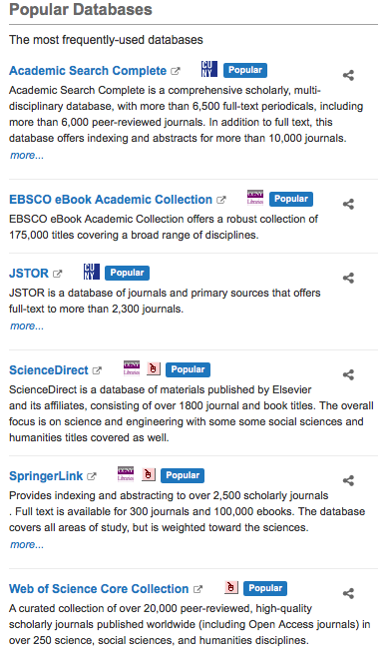

Slide 4
NARROW DOWN YOUR TOPIC
START OUT GENERAL -
Who?
What?
Where
When
What

Slide 5
HOW DOES IT FIT IN YOUR PAPER?
Read and Analyze your source to see how it can fit into your research topic.
When you pinpoint a specific quote-place it into your essay and examine how it can support your point with a smooth transition
Does it simply restate what you said?
Does it conflict with your argument or statement?

Slide 7
RECAP OF APA CITATIONS

